Slide 1

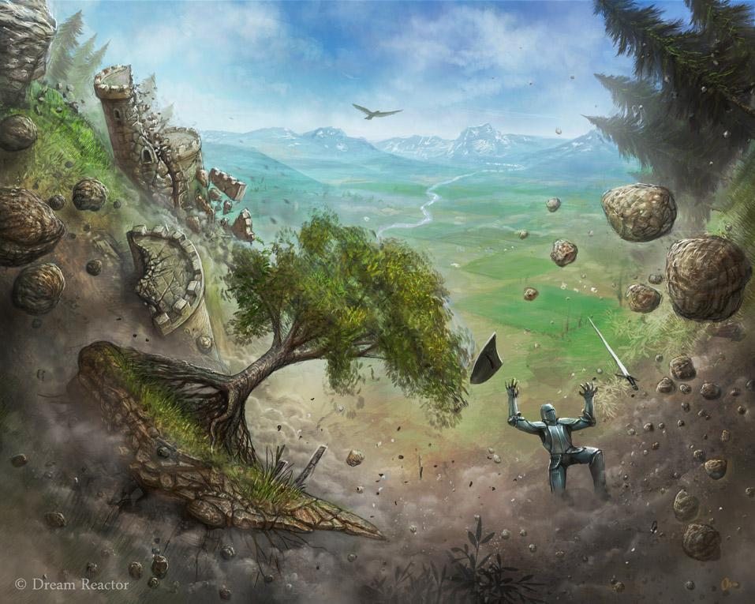
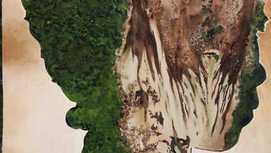

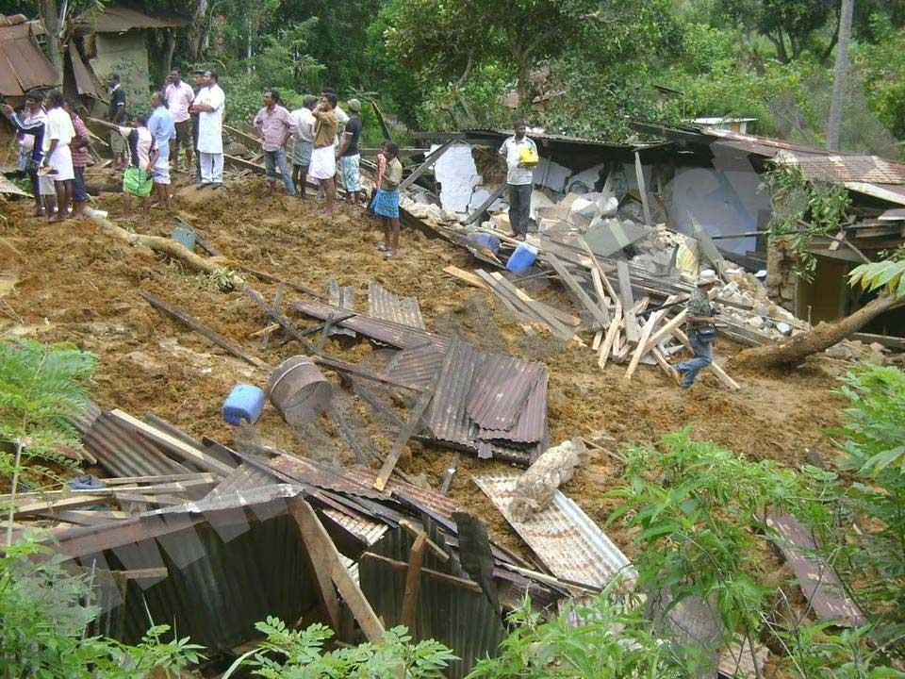
Siren: Landslide Threat Alert Application
IDENTIFYING RISK WITH SCIENCE + COMMUNITIES
Project by Team Cifra

Slide 2
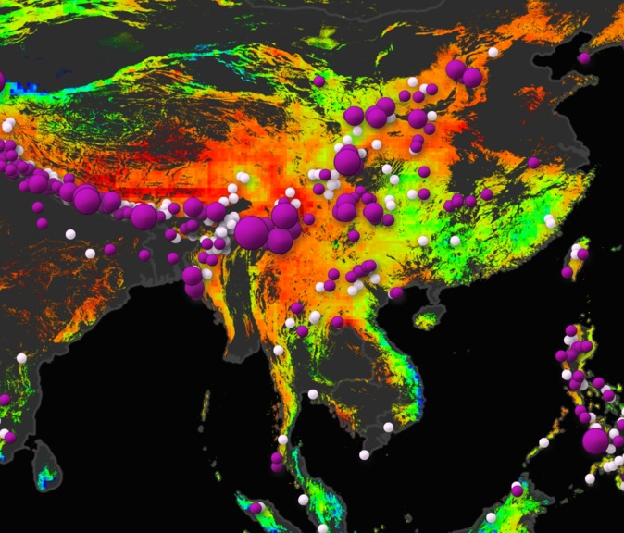
The Challenge
IDENTIFYING RISK WITH SCIENCE + COMMUNITIES
To develop a tool that uses data from NASA satellites and ground-based sources to determine the risk of landslides in rural communities and share the results with local communities and governments.

Slide 3
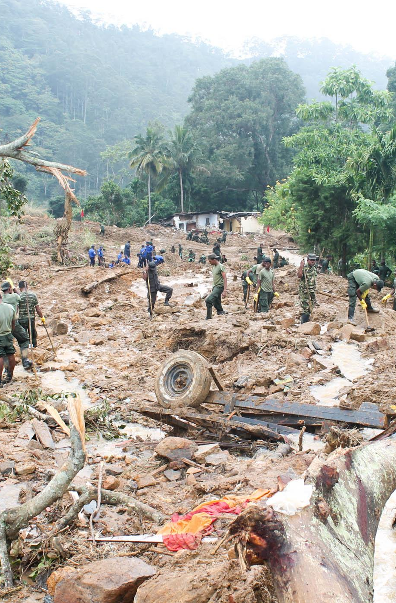
Why?
The heavy rains caused flooding and landslides impacting 13 districts in Sri Lanka.
According to the Disaster Management Centre’s (DMC) situation report as of 23 December 2019,
a total of 65,316 people (19,072 families) were affected
two persons reported dead
one person reported missing
62 houses fully damaged and 1,463 houses partially damaged.
17,776 people (5,277 families) were evacuated to 133 safe locations.
(Sri Lanka: Floods and Landslides - Final Report, IFRC)
29 October 2014, a landslide struck the Sri Lanka district of Badulla, killing at least 16 people and leaving an estimated 200 missing.
List goes on…..

Slide 4
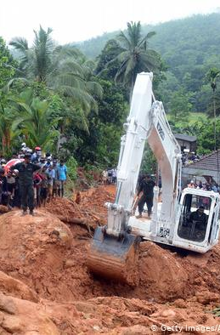
Why?
Why chose this kind of implementation?
Approximately 20,000 km2 (30.7%) of the acreage of Sri Lanka is highly at risk of landslides.
Landslides have become a major threat to the social, economic, and environmental aspects of Sri Lanka.
Therefore, identification of landslide susceptible areas associated with the terrain and making the community aware of the threat level is important to minimize the threats.
We saw the need of alerting people right at time during rainy seasons to take necessary precautions.
Landslides does not cause only by heavy rainfalls. It’s triggered by many other factors as well.
Spatial probability of landslide event itself can be identified through landslide susceptibility mapping which is used in our mobile application.
It will save lives.

Slide 5
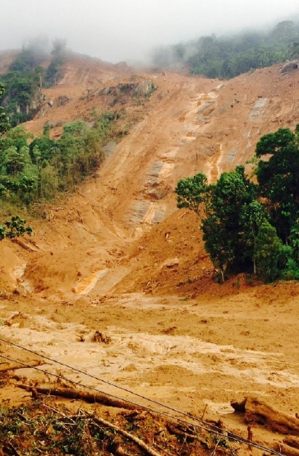
Objectives
To develop an awareness of the community about the threat level they are in
To develop a Landslide Susceptibility Map using WoE models
To provide an improved decision support tool for hazard managers and planners
to incorporate Earth observations (as satellite data) with local open data provided by national entities and scientific institutes.
Motivate the general public can contribute by capturing data in their territories to improve the precision of the analysis.

Slide 6
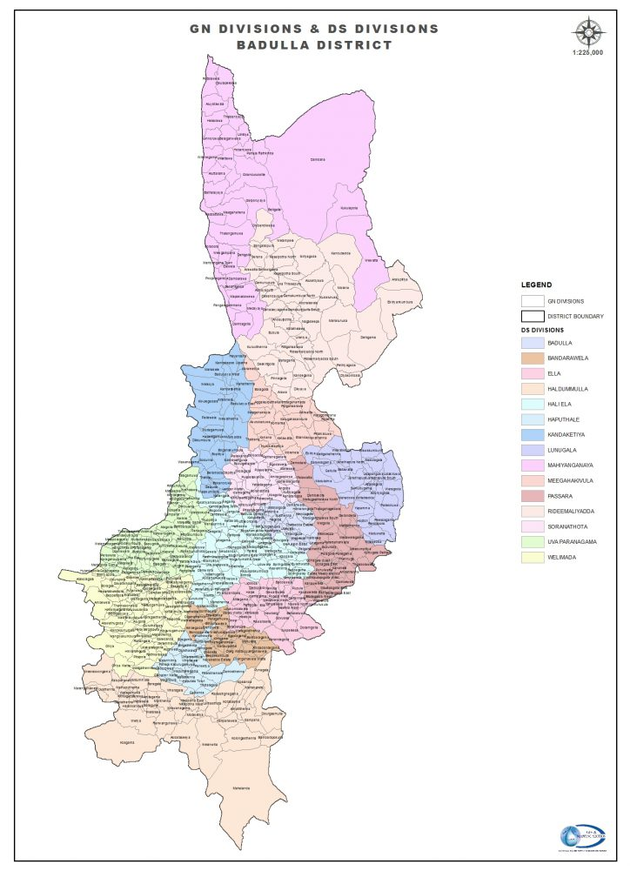
Study Area
The study was focused on landslide susceptibility mapping in Badulla District, which is situated in the Uva province between 6º 59’ 05” of North latitude and 81º 03’ 23” of the East longitude of Sri Lanka, using causative factors and application of WoE models. The district covers about 2871 sq. km of land area with altitudes varying from 50 to 2530 m above sea level.
Most of the land area is mountainous, with the growth of population, there is an increasing demand for the lands and utilization of land. Most of the landslide incidents occur due to heavy rainfall.
There is great variation in the rainfall amounts with maximum rainfall occurring during the fall of the year with the heaviest rainfall occurring during the months of October and November.

Slide 7
Questionnaire(Sample of 60)

Slide 8
Here we focused on two main sectors.
Rainfall at the moment.
Here we consider rainfall condition data and duration of rainfall. Then, calculate occurrence probability of landslide because of rainfall(Using machine learning model)
Conditions of the land.
Here we considered whether the landslides causative factors related to surface. And, checked whether those factors met the relevant condition to cause a landslide by the use of susceptibility map(WoE model)
Using conditional probability of above sectors, we predict the final risk.

Slide 9
Factors We Considered
Landslide Inventory Locations
Digital Elevation Model of Badulla District
Slope data
Curvature data
Distance to stream data
Lithological data
Rainfall data
Landuse data

Slide 10
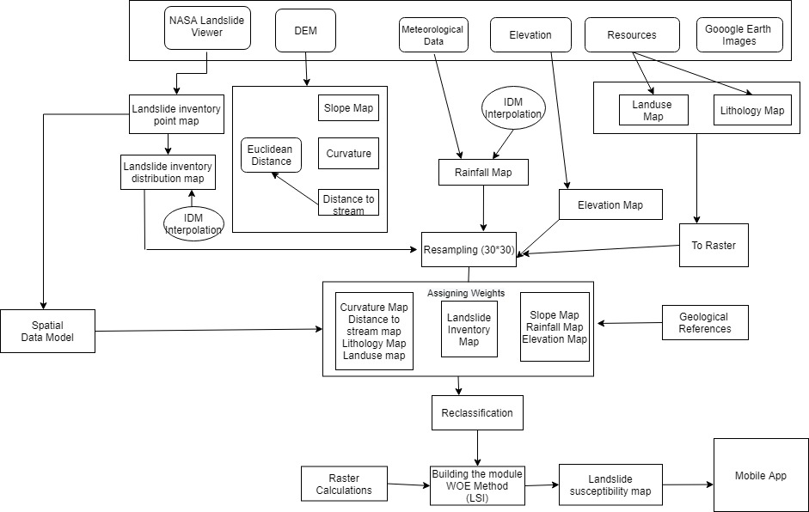
Methodology(Landslide Susceptibility Map)
IDW

Slide 11
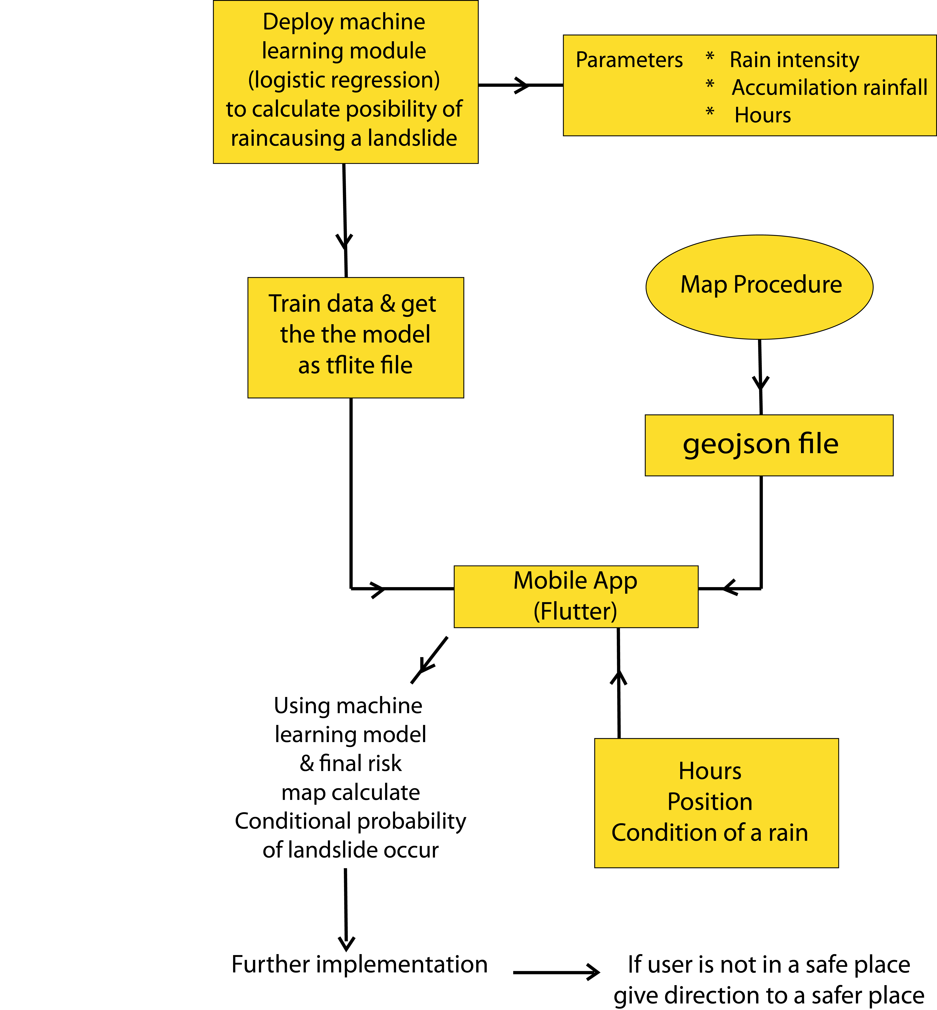
Methodology(Mobile Applications)

Slide 12
Data Collection
Used Applications Data Processing
Rainfall data
Climate Data Org
Landslide inventory data
NASA global landslide inventory
Lithology data
ORR & Associates
Distance to stream data
DEM
Land use data
Google Earth
Curvature/Slope/Aspect data
DEM
Arc GIS 10.8
QGIS
Geo Mapper
SuperMap
ERDAS Imagine
Used Applications for mobile app development
Machine learning model
-python (Google colabs)
Mobile app
-Flutter (Android studio)

Slide 13
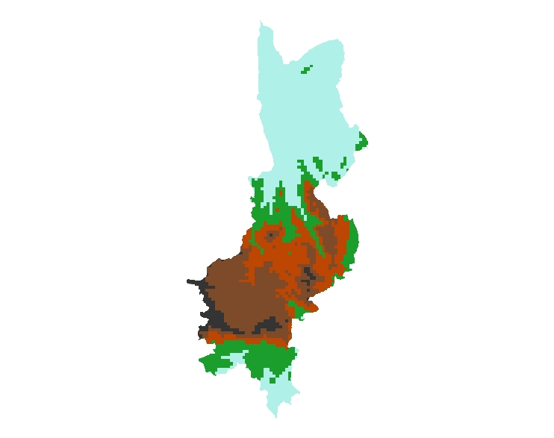
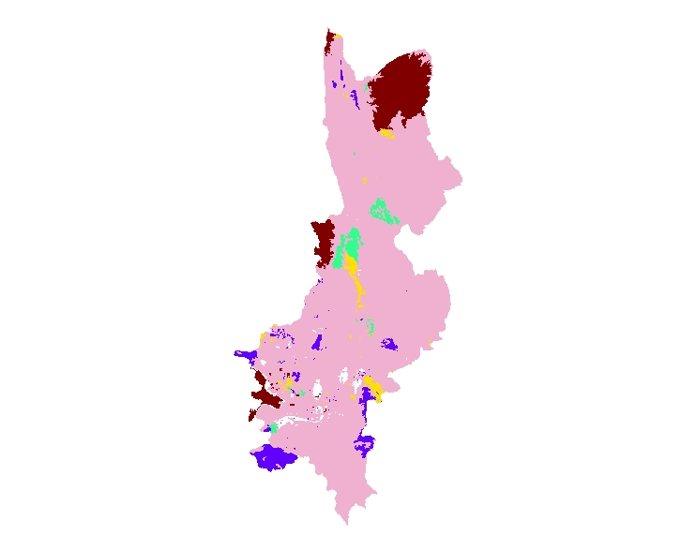
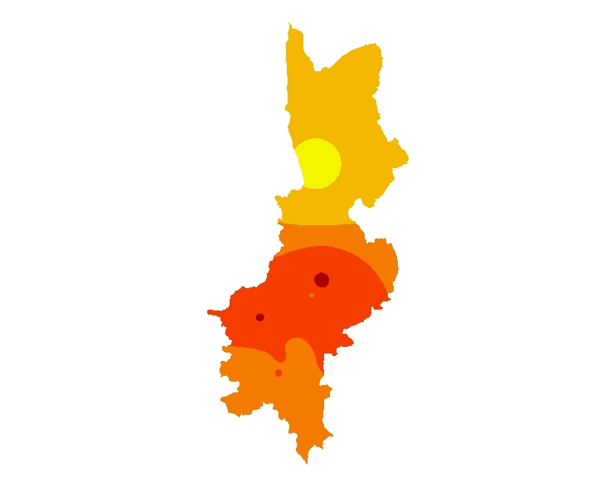
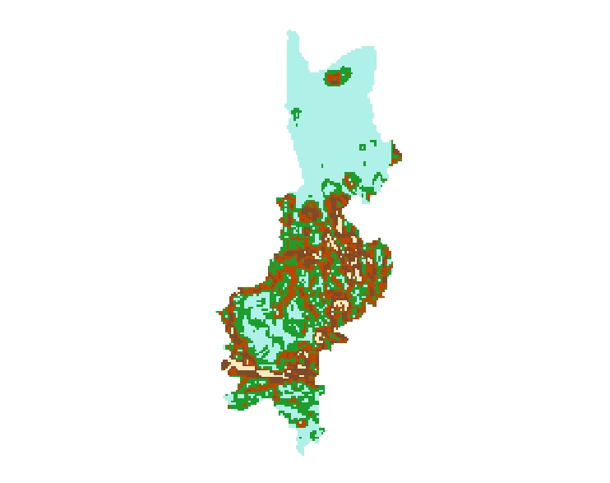
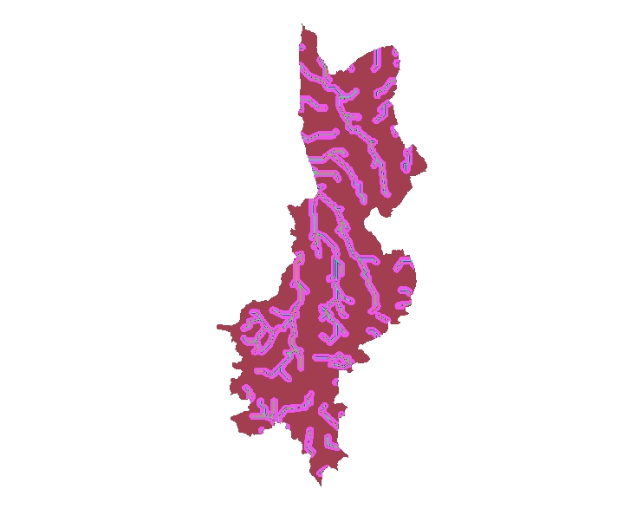
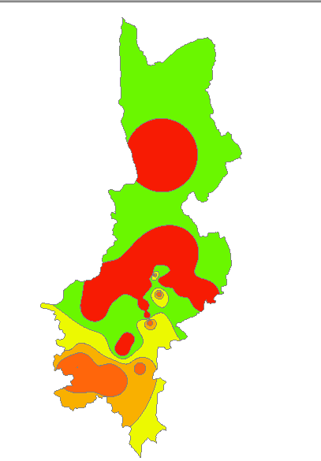

Landslide Causative Factors
Each factor map was divided in to certain weight classes.
1
2
Slope
Range(degrees) | Values
0.0 to 2.3 | 1
2.3 to 5.6 | 2
5.6 to 9.3 | 3
9.3 to 15.2 | 4
15.2 to 90 | 5
Elevation
Range(meters) | Values
0 to 312 | 1
312 to 660 | 2
660 to 1029 | 3
1029 to 1431 | 4
1431 to 2203 | 5
3
4
5
6

Slide 14
I
Rainfall Map
Range(mm) | Values
0.0 to 72.9 | 1
72.9 to 90.1 | 2
90.1 to 95.9 | 3
95.9 to 100.1 | 4
100.1 to 150.7 | 5
Landuse Map
Feature | Values
Urban Lands | 1
Forest Lands | 2
Rangelands | 3
Barren Lands | 4
Agriculture | 5
Distance to stream Map
Range(meters) | Values
150 to 200 | 1
100 to 150 | 2
50 to 100 | 3
0 to 50 | 4
More than 200 | 5
Inventory Map
Type | Values
Very Low Risk | 1
Low Risk | 2
Moderate Risk | 3
High Risk | 4
Very High Risk | 5
Lithology Map
Range(mm) | Values
Weathered tuff | 1
Rhyolite/trachytc | 2
Residual | 3
Coluvial | 4
Aluvial | 5
Curvature Map
Type | Values
Flat | 1
Convex | 2
Concave | 3

Slide 15
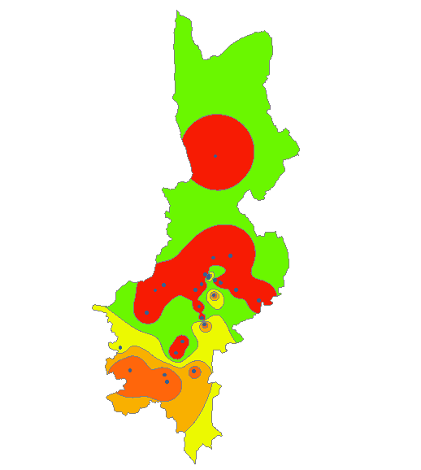
Inventory Map
Data source: NASA Map & App Gallery - Global Inventory Map

Slide 16
Weight of Evidence
Factor | Resource | Weights
Landslide Inventory | NASA Landslide Viewer | 20
Rainfall | Climate Data Org | 25
Elevation | Diva-GIS | 10
Slope | DEM | 15
Curvature | DEM | 7
Lithology | ORR & Associate | 8
Distance to Stream | DEM | 10
Land Use | Google Earth | 5

Slide 17
Risk Map Module
LAND SLIDE SUSCEPTIBILITY INDEX (LSI)
LSI= ((w1*x1)+(w2*x2)+(w3*x3)+(w4*x4)+(w5*x5)+(w6*x6)+(w7*x7)+(w8*x8))
8
W1,W2,W3,W4,W5,W6,W7,W8 are the weights of the classes (factors)
X1,X2,X3,X4,X5,X6,X7,X8 are the categories of the factors
8 is the number of factors
LSI was classified into susceptibility categories,
-Very Low Risk
-Low Risk
-Moderate Risk
-High Risk

Slide 18
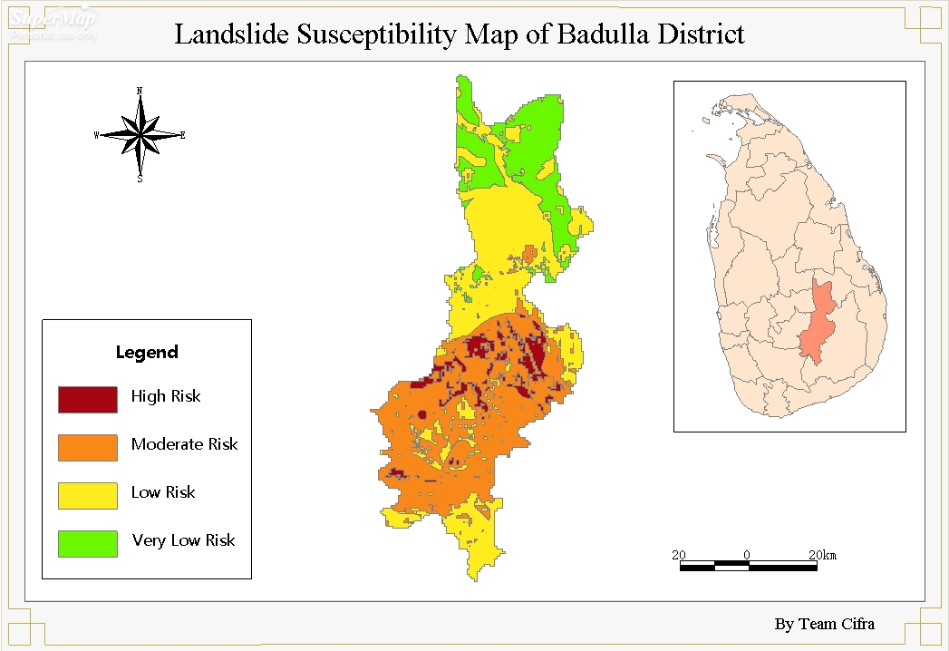
Landslide Susceptibility Map

Slide 19
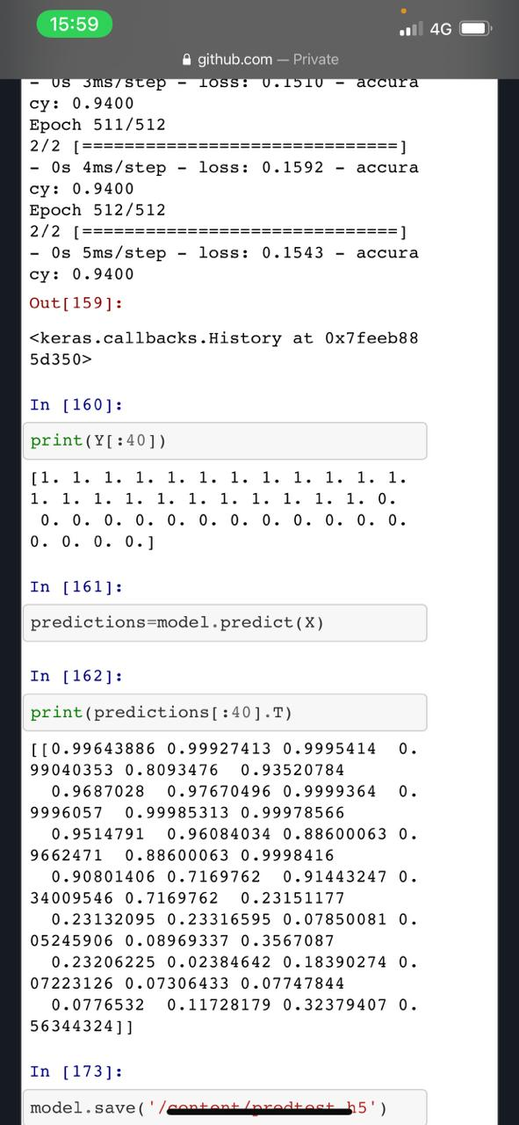
Mobile Application

Slide 20
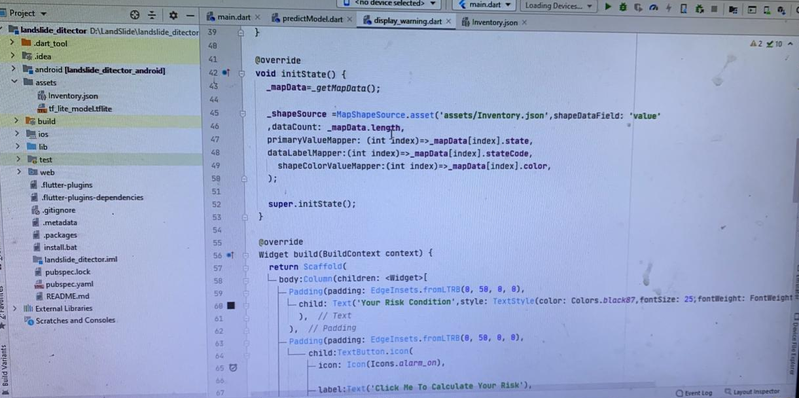
Mobile Application

Slide 21
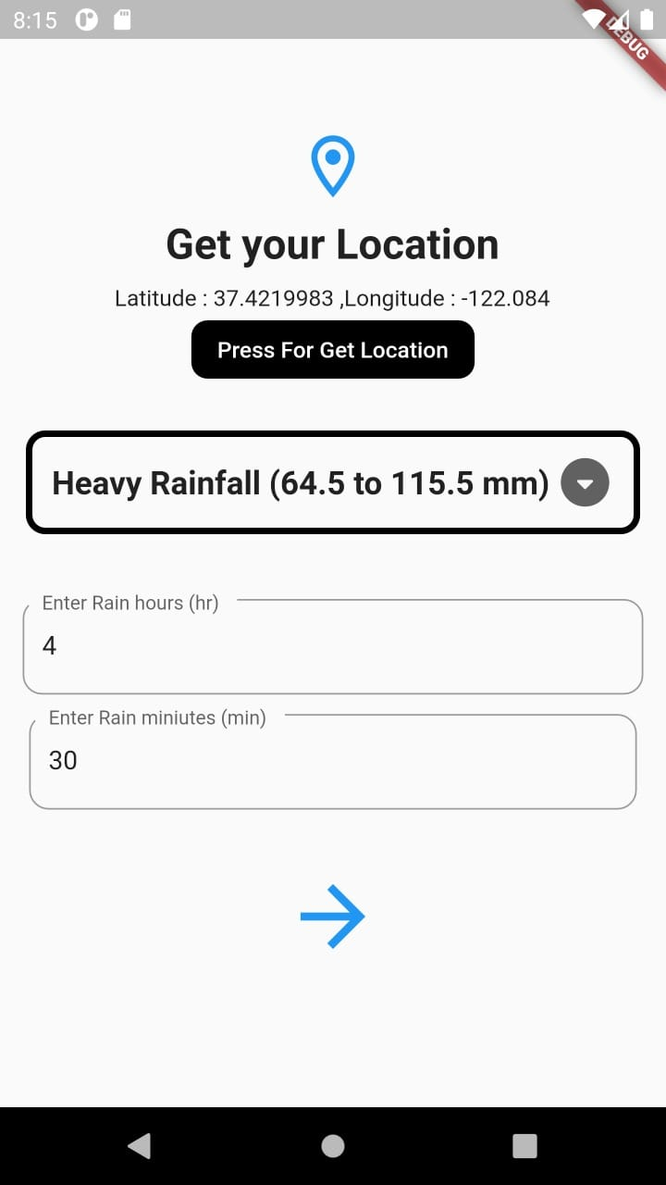
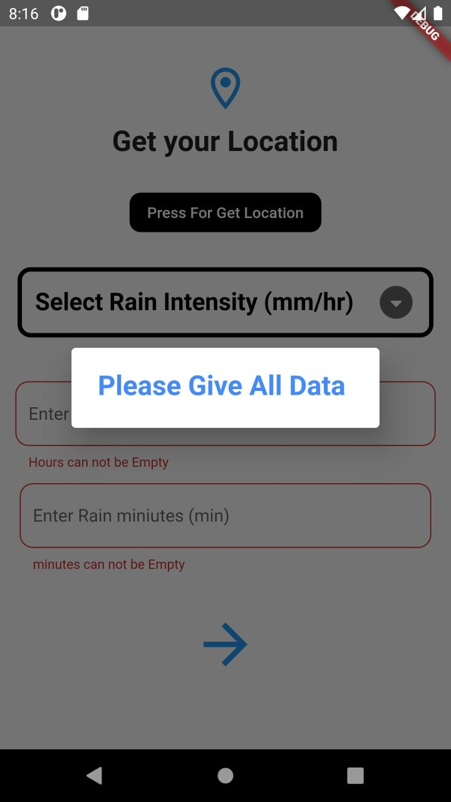
Mobile Application

Slide 22
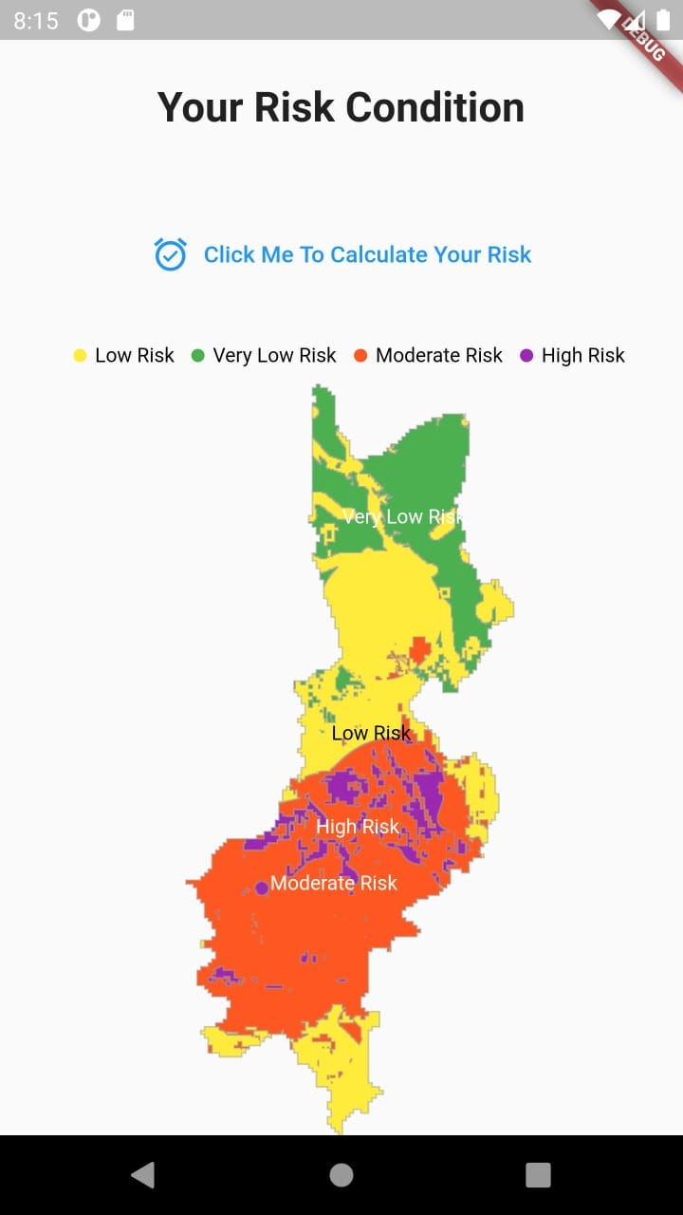
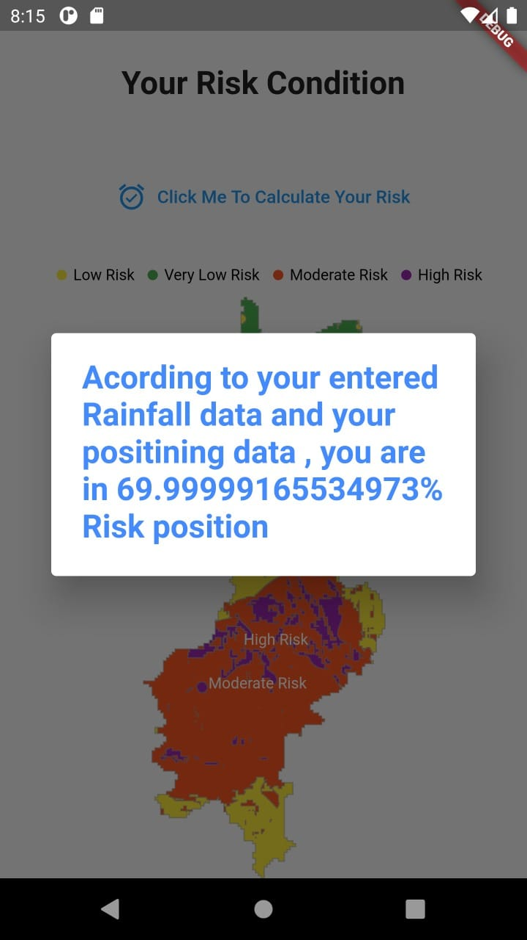

Slide 23


Thank You
Team Cifra
Cifra.solutions.geo@gmail.com

